Slide 1
Master Thesis Project: Bending-Twist Shape Adaptation of Wings by Compliant Chiral Spar Design
Alejandro Valverde López, Cranfield University
Advisors: Runkel, Falk; Keidel, Dominic; Urban Fasel

Slide 2
Report
Status
Introduction
State-of-the-art
Wing-box model
Model analysis
Simulations results
General response characterization
Parametric study on the computational model

Slide 3
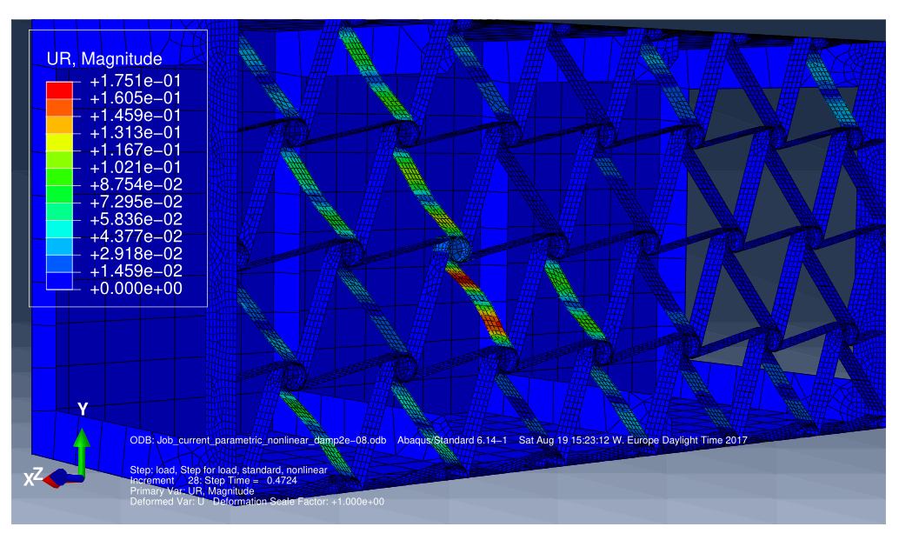
General response characterization
Stage 1

Slide 4
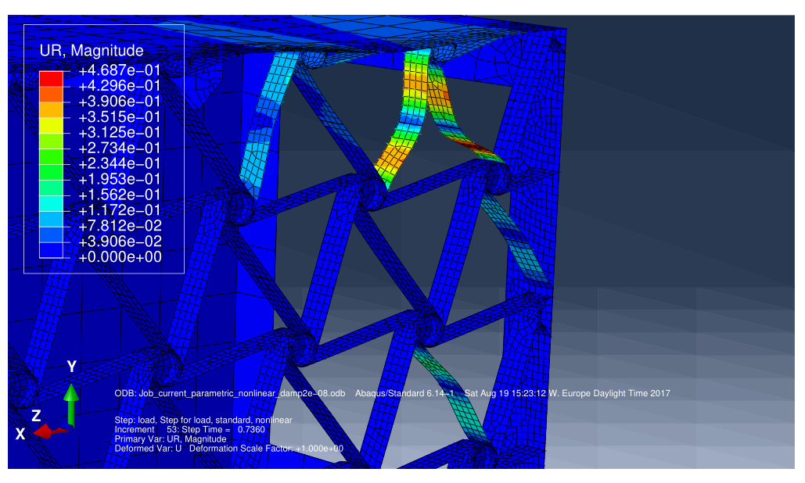
General response characterization
Stage 2

Slide 5
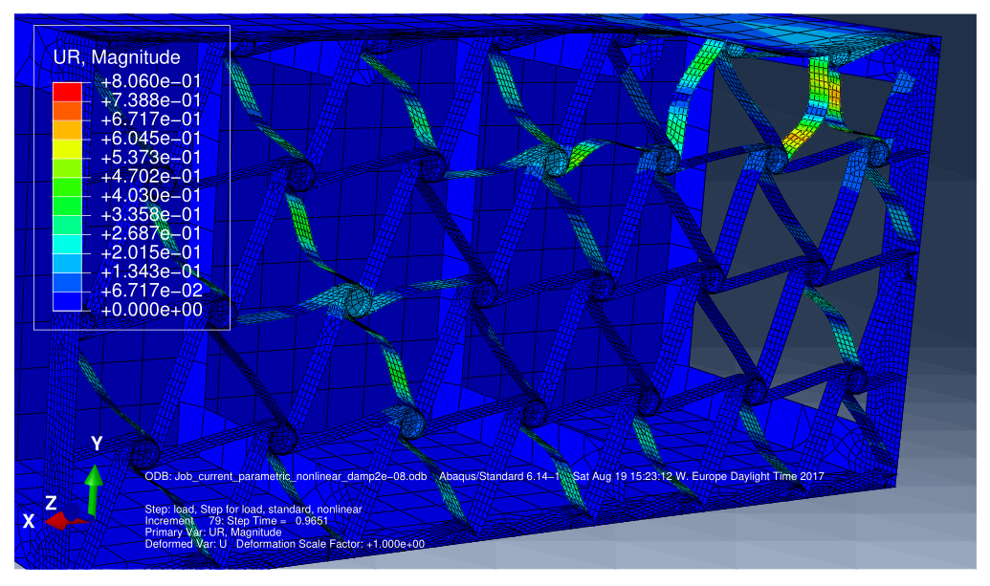
General response characterization
Stage 3

Slide 6
Parametric study
Variables
• Wing-box thickness
• Number of unit cells in the transversal direction
• Number of unit cells in the spanwise direction
• Chiral node depth
• Chiral node radius
• Chiral lattice thickness
• Chiral ligament half length
• Dimensionless ligament eccentricity

Slide 7
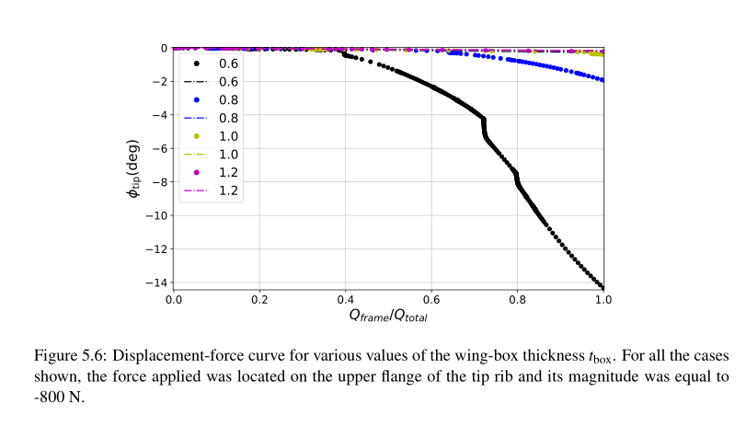
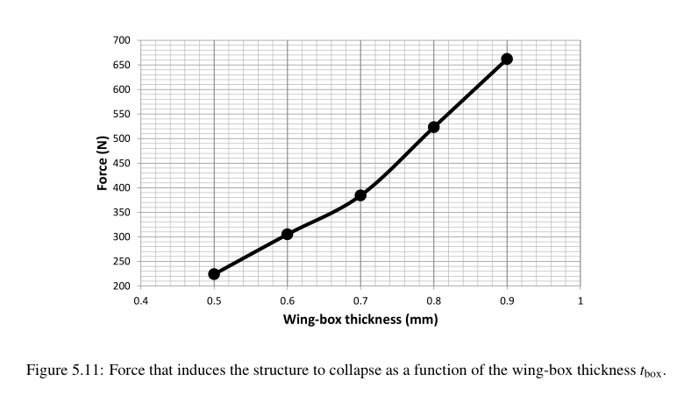
Parametric study
Wing-box thickness

Slide 8
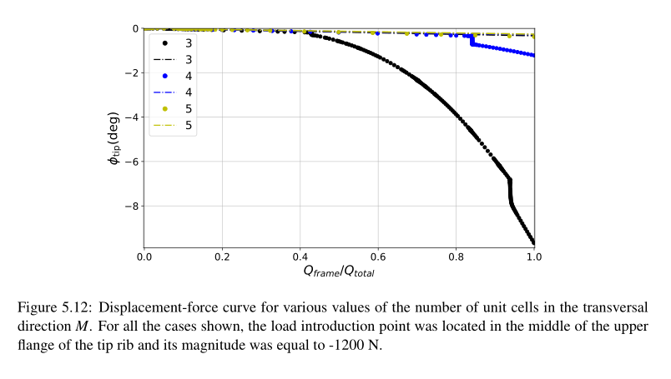
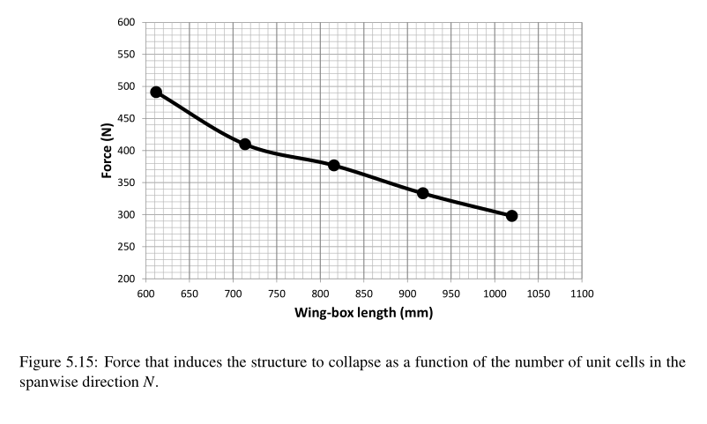
Parametric study
Number of cells (wing-box length and height)

Slide 9
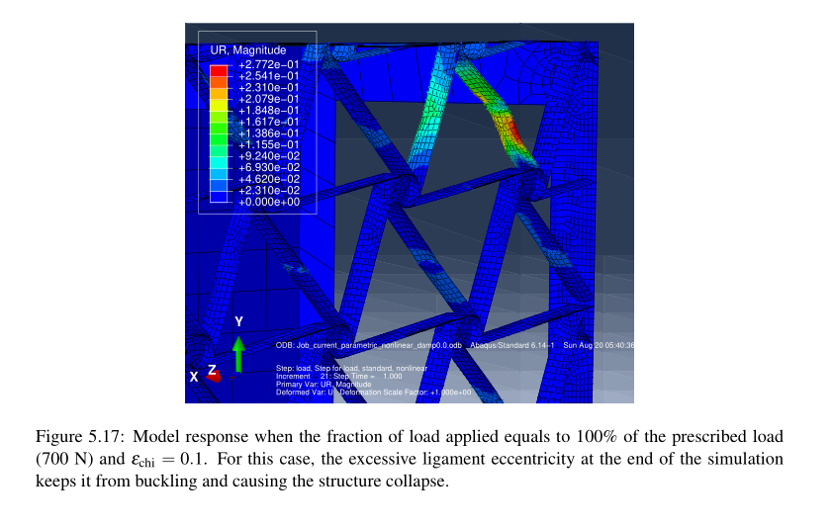
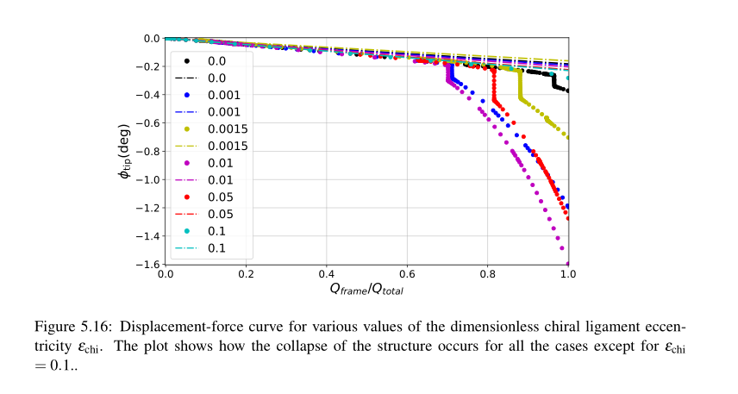
Parametric study
Dimensionless ligament eccentricity

Slide 10
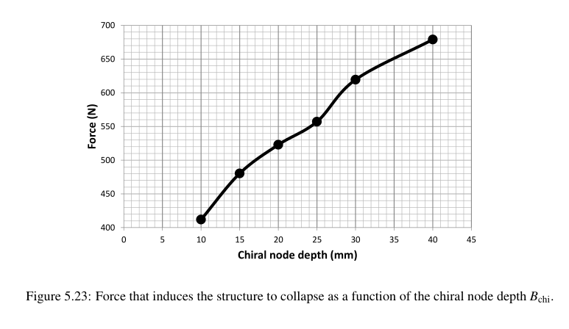
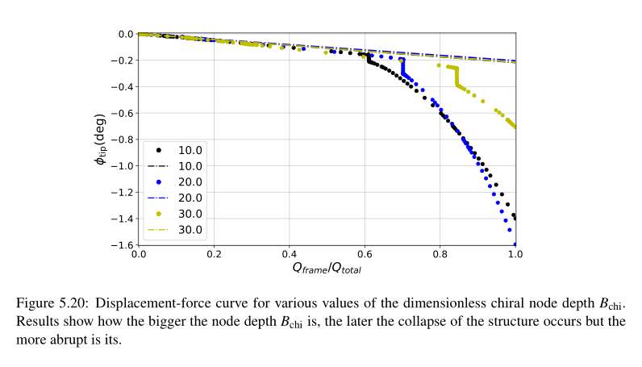
Parametric study
Chiral node radius

Slide 11
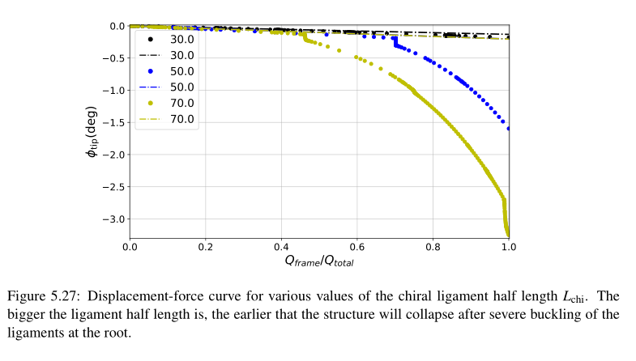
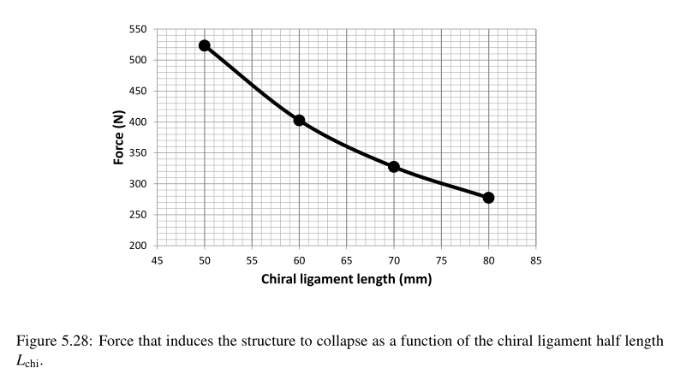
Parametric study
Chiral ligament half length

Slide 12
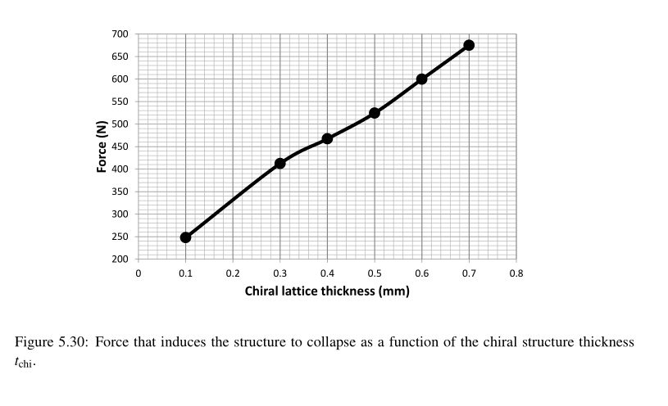
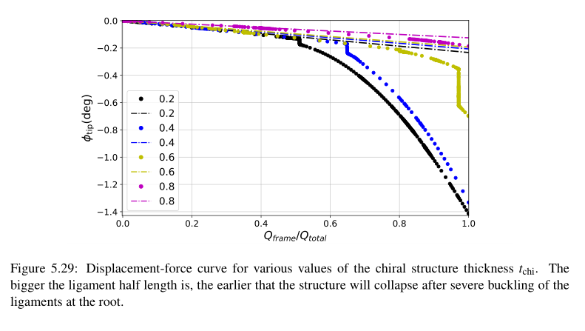
Parametric study
Chiral ligament half length

Slide 13
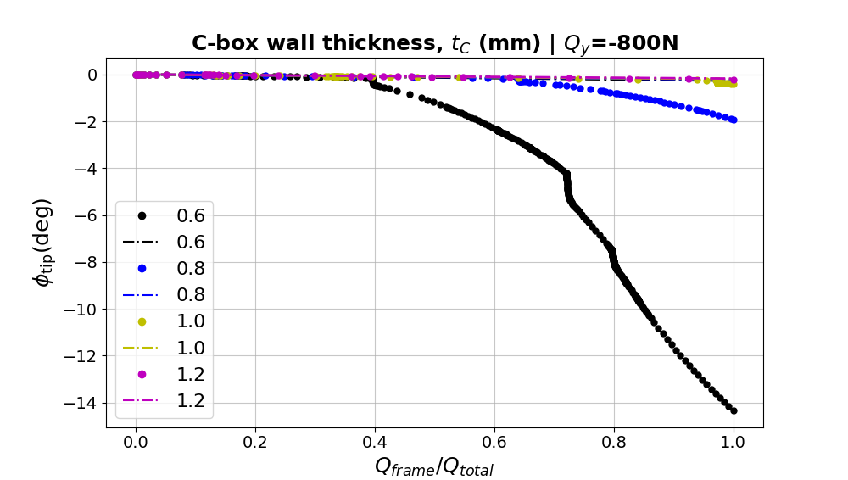
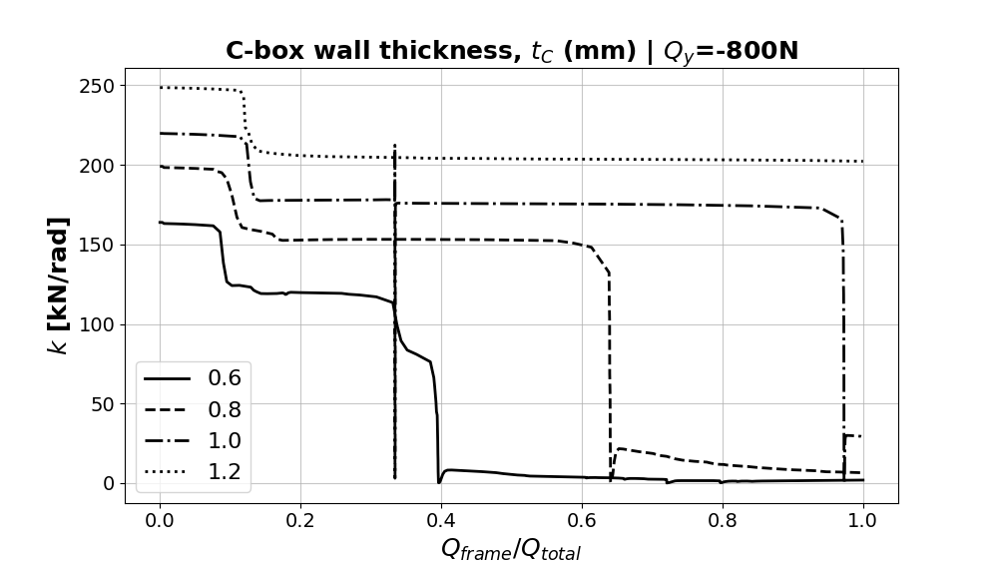
Further analysis
Change in stiffness

